Slide 1
Employee Attrition Problem
Why are employees leaving?
Presentation by: Adetola Oluwatoyosi

Slide 2
Overview
The company has total of 14,999 employees, out of which 3571 have left.
Each employee has the following attributes:
Satisfaction level
Average monthly hours
Whether they have had a promotion in the last 5 years
Last Evaluation
TIme spent at the company
Salary categories
Number of Projects
Whether they have had a work accident
Departments

Slide 3
Methodology
The following steps were adopted in solving the given problem:
I carefully studied the two datasets given
I merged the ‘existing employee’ dataset with the ‘ex-employee’ dataset in order to obtain a more ‘comprehensive dataset’.
I created a new column (left_company) in the ‘comprehensive dataset’ with value ‘1’ representing the employees that have left the company, and value ‘0’ for the employees still existing in the company.
I processed and analysed the ‘comprehensive dataset’ using descriptive statistics
I visualized the results of data analysis using tableau
I presented my results, concluded and made predictions using google slides.

Slide 4
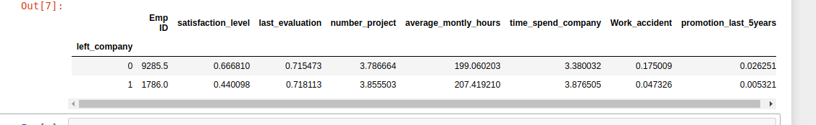
Observation
NOTE:
1 - FOR EMPLOYEES WHO HAVE LEFT
0 - FOR EMPLOYEES STILL AT THE COMPANY
Based on the average values for 'satisfaction_level', 'average_monthly_hours', 'number_project', 'time_spend_company' and 'promotion_last_5years'; it can be observed that employees left the company because they were not satisfied (0.440098) and worked the longest (207 hours) because of the number of projects (3.8) they had to do.
The employees that left also spent more time (3.8) at the company without being promoted for 5 years (0.005321).

Slide 5
Exploratory Analysis using Tableau
Data visualization is necessary for better understanding of the dataset.
Reading deep into the employee dataset.

Slide 6
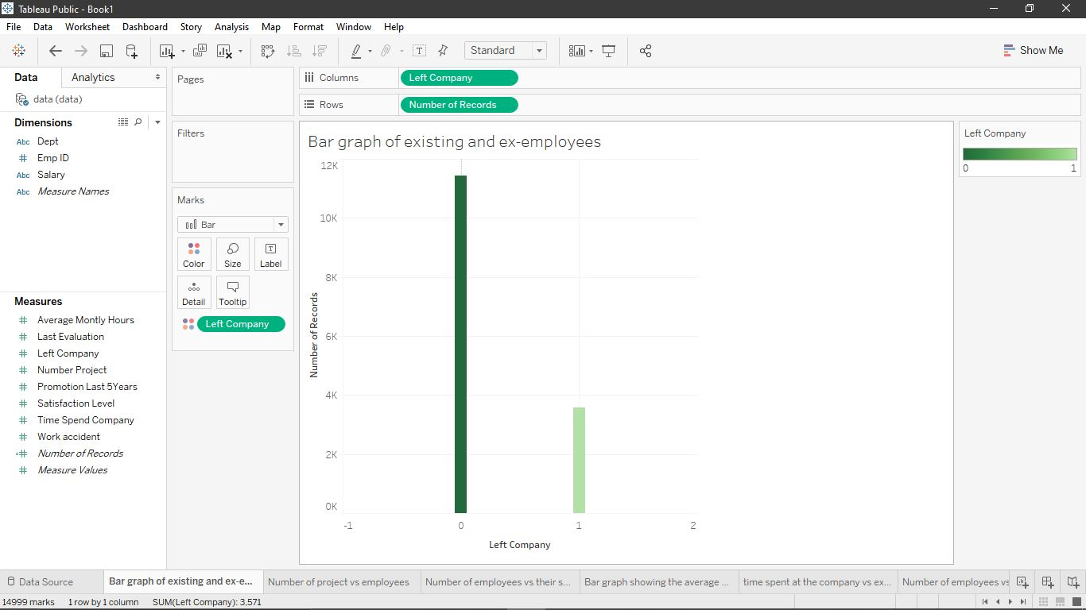
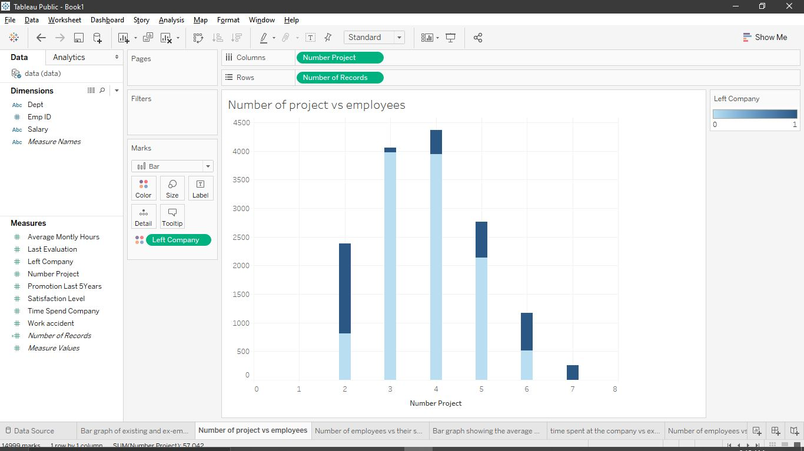
Exploratory Analysis (Using Tableau)
Fig 2: Relationship between the number of projects and employees
Most employees have between 3-5 projects. There are two categories of employees that left the company:
The first category had 2 projects probably because they were not properly evaluated or they were not satisfied. The second category of employees that left are those who had over 5 projects to do. They might have left because of work overload.
Fig 1: Relationship between the existing and the ex-employees.
23.8% employees have left the company, while 76.2% employees are still remaining. This implies that the company has a low turnover of employees.

Slide 7
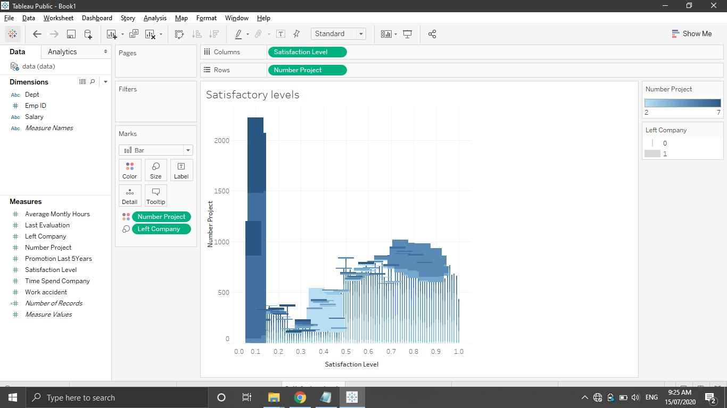
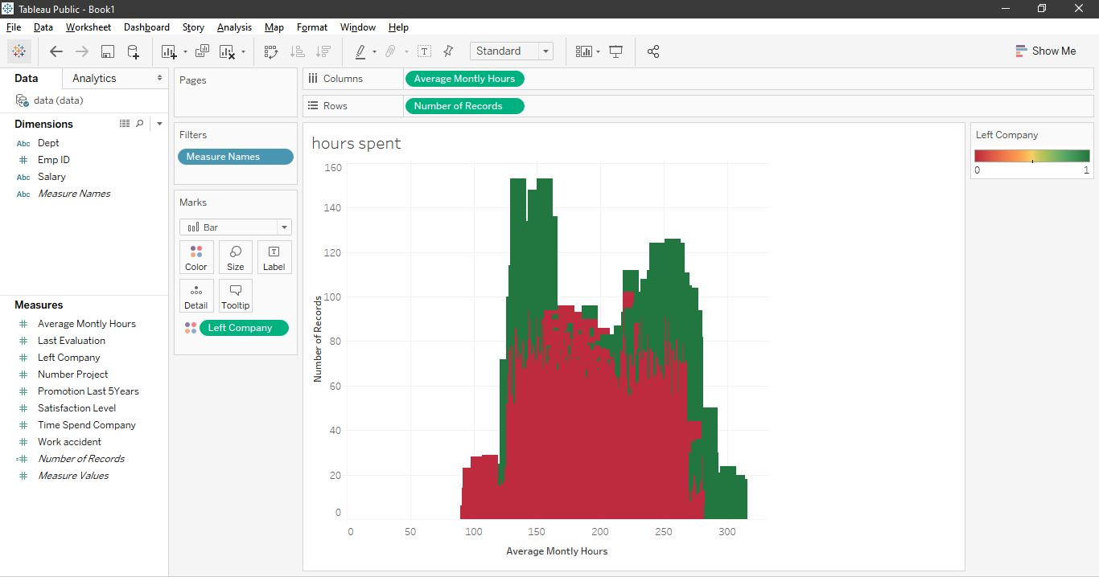
Exploratory Analysis (Using Tableau)
Fig 3: Relationship between number of projects, satisfactory level and employees.
Employees that left had an extremely low satisfaction level and they had more than 5 projects to do.
Fig 4: Relationship between hours spent in the company and employees.
Employees who had spent over 250 average hours left because of the high number (overload) of projects in the company.

Slide 8
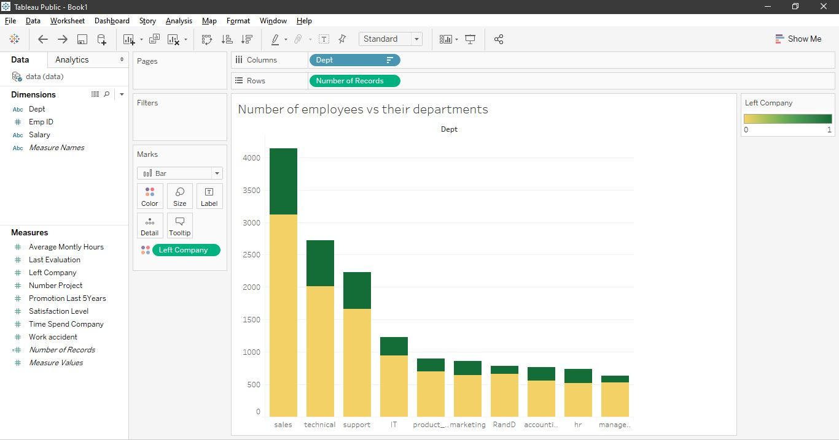
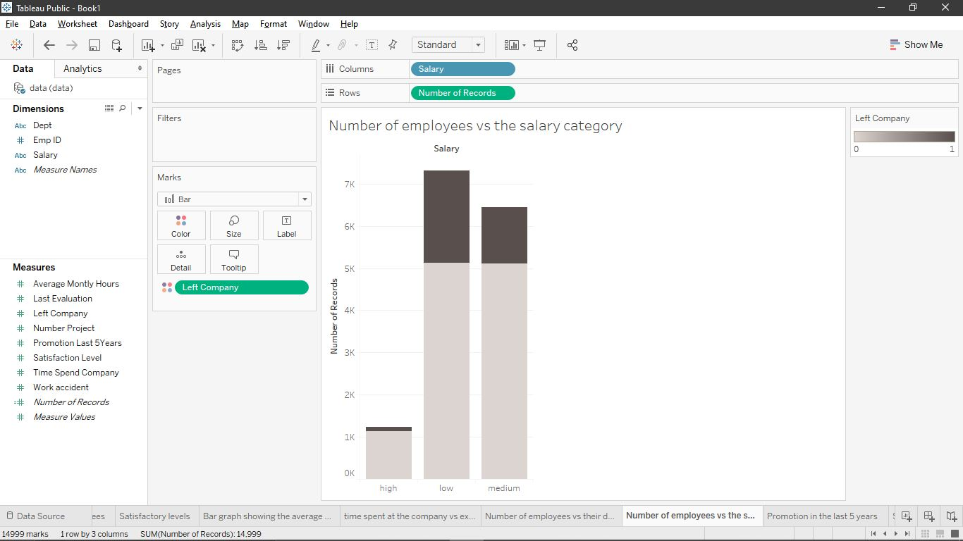
Exploratory Analysis (Using Tableau)
Fig 5: Relationship between departments and employees.
Most of the employes are in the sales, technical and support departments. Majority of the employees that left (about 2000) were from this three departments too.
Fig 6: Relationship between salary categories and employees
The company has three categories of salary earners (low, medium and high). Most employees in the company earn low salaries. Majority of the employees that left earned low and medium salaries

Slide 9
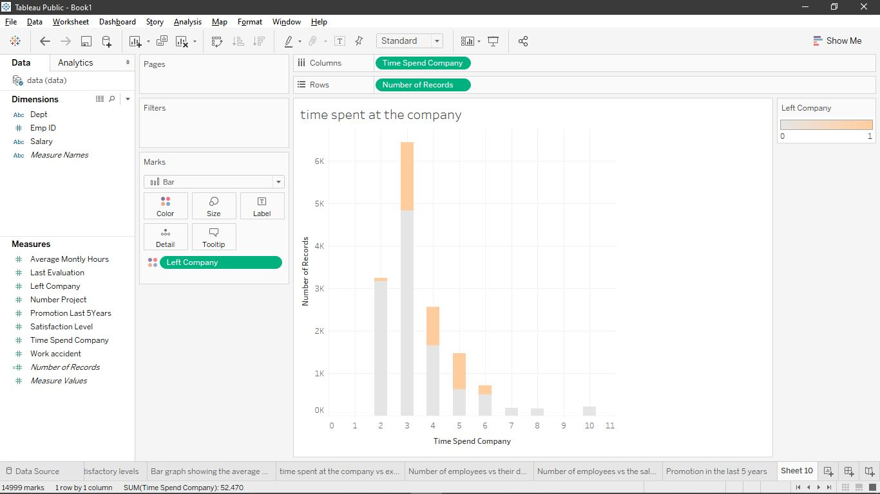
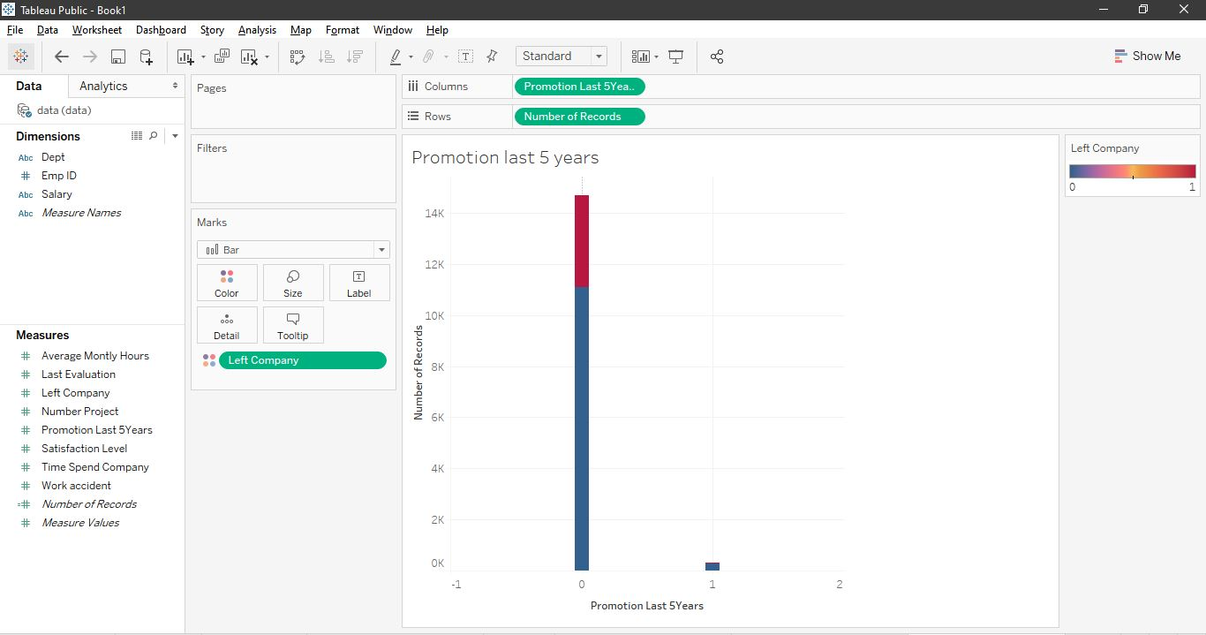
Exploratory Analysis (Using Tableau)
Fig 7: Relationship between employees and promotion in the last 5 years.
From fig 7 above, about 99% of the employees in the company have not been promoted in the last 5 years. All the employees who left the company have not been promoted in the last 5 years.
Fig 8: Relationship between the employees and the time spent at the company.
Most employees who left had spent between 3-5 years in the company. Over 50% (1800) employees who left the company have not been promoted in the last five years.

Slide 10
Conclusion

Slide 11
Conclusion / Future Prediction
From the findings of this study,
Employees who have not been promoted in the last 5 years are most likely to leave.
More employees within the low salary category are going to leave.
Employees that have spent between 3 to 5 years without promotion are going to leave.
Employees that have spent over 250 hours (overworked) at the company are going to leave also.
More employees who have over 5 projects are going to leave because of their low satisfaction levels.
More employees in the sales, technical and support departments are going to leave.

